Slide 1

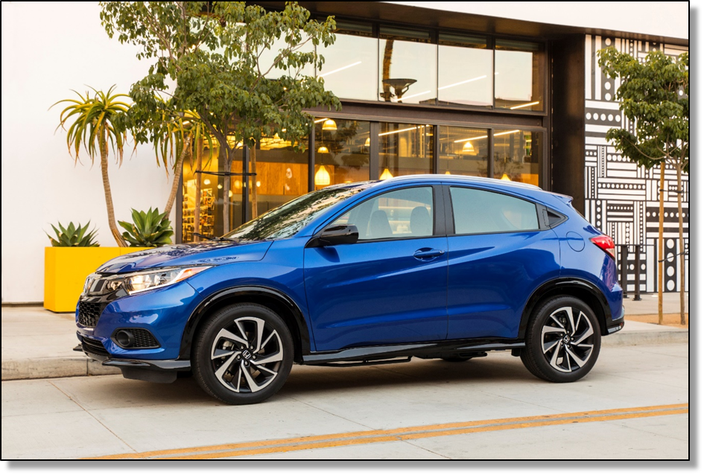

February 2020 SARG
2019 Honda Odyssey

Slide 2

Honda North America HR&E
SARG Mtg. Agenda
February 6, 2020
American Honda
101 Stanfield Road, Troy, OH
AGENDA
8:00 – 8:30 Registration & Lite Breakfast
8:30-9:30 Welcome and Introductions – HNA Top Exec. Updates - Patrick Easton, HNA
9:30-10:30 HR Interest Presentation – Anne Marie Singleton, McGohan Brabender 10:30-10:40 Break
10:40-11:40 Best Practice Presentation – “Using PDCA for Onboarding/Training Success” – Karolyn Hofacker, GTI
11:40 – 12:00 Lunch
12:00-1:00 Training Workshop – “Millennials & Generation Z: Reducing Attrition and Unlocking your Company’s Productivity” – Aurora Training Advantage
1:00-2:00 HMA Plant Tour
2:00-2:30 Supplier Stability Program/SARG Updates/Open Discussion
– Tim Hites & Julie Feltovich, HAM; Patrick Easton, HNA
2:30 Adjournment

Slide 3

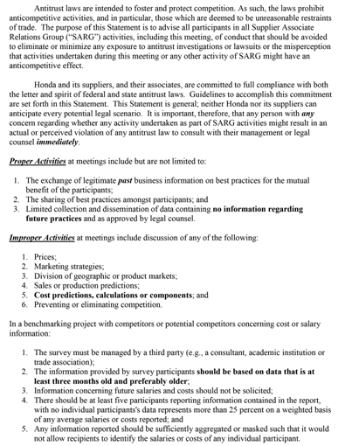

Slide 4
AGREEMENT
Common
(AE)
Intention Statement:
It is our intention as members of the Supplier Associate Relations Group to create a “safe space “ meeting environment.
Shared Beliefs for Creating Safe Space
We believe a safe space environment:
Respects confidentiality. We maintain a shared understanding that information shared may be sensitive. In this respect, it might not be ready for public consumption, or has not been properly vetted internally.
Encourages relationship building. We value networking and opportunities to get to know each other beyond work.
Is trusting and open. We value honesty, realizing that the work we do, is all not just rainbows and puppy dogs. We want to hear the “other stuff” too. .
Is non-judgemental. We value and allow time for the exploration of new ideas. We practice focusing on the possibilities first before making any final determinations of practicality. We understand everyone’s experiences vary and as a group we can grow from them. As a trusted group, we can escalate positive growth both personally and professionally.
Is respectful. We value and seek to understand the unique perspectives each of us might hold based on the size of our organizations, our time in role, professional background and experience, geographic location, etc.
Notes:
Basic requirements
Work environment with open-mindedness and free expression
Work with job satisfaction
Environment that recognizes effort and performance
Pride in being a Honda associate
Confidence in management

Slide 5

URWHO?
EIEIO Parts
My Biggest Concern for 2020

Slide 6
Honda North America HR&E
SARG Mtg. Agenda
February 6, 2020
American Honda
101 Stanfield Road, Troy, OH
AGENDA
8:00 – 8:30 Registration & Lite Breakfast
8:30-9:30 Welcome and Introductions – HNA Top Exec. Updates - Patrick Easton, HNA
9:30-10:30 HR Interest Presentation – Anne Marie Singleton, McGohan Brabender 10:30-10:40 Break
10:40-11:40 Best Practice Presentation – “Using PDCA for Onboarding/Training Success” – Karolyn Hofacker, GTI
11:40 – 12:00 Lunch
12:00-1:00 Training Workshop – “Millennials & Generation Z: Reducing Attrition and Unlocking your Company’s Productivity” – Aurora Training Advantage
1:00-2:00 HMA Plant Tour
2:00-2:30 Supplier Stability Program/SARG Updates/Open Discussion
– Tim Hites & Julie Feltovich, HAM; Patrick Easton, HNA
2:30 Adjournment

Slide 7
HNA What is New?
Upcoming Events
HOST
2020 Meeting Schedule
Topics for Discussion
Infectious Disease
Weather Policy
Copyright Information
2020 Wage and Benefit Survey
Supplier Stability Update

Slide 8
SARG
2/6: Am. Honda, Troy OH
5/12: Lean Conference, Covington KY
8/13: Skype Update Call
9/24-25: Law Review, Columbus OH
11/19: TS Tech or Midwest Exp (tnt)
SSARG
3/11: SE Law Review, Columbia SC
4/7: Burr Forman, Birmingham, AL
6/18: Skype Update Call
9/2: @HSC
12/1-3: Meeting & Law Review, Nashville TN
MSARG
3/25: TBD
6/3: TBD (Supplier/QH Run)
9/9-10: Meeting & Law Review @HDM, Celaya
NSARG
2/20: Kumi Canada, Bradford
4/28: TBD, Niagara-on-the-Lake
8/20: TBD
11/17-18: Meeting & Law Review, Markham ON
CAN/HOST
2/11: SCAN/SHOST, AIDT
2/12-13: Southern Skill Summit, AIDT
4/2: Central HOST, HHC
4/28-30: CAN Spring Conf, Niagara ONT
8/6: NCAN/NHOST, TBD ONT
8/19-20: Central Skill Summit, HHC
9/29-10/1: CAN Fall Conf, Knoxville TN
10/16: Central HOST, TBD OH
10/19-23: NAB Conf, North Carolina
OTHER
5/3-5: CUE Spring Conf, New Orleans LA
6/28-7/1: SHRM Conf, San Diego CA
10/11-13: CUE Fall Conf, Louisville TN
SARG Schedule 2020
Draft 12-3-19
January 2020
S | M | T | W | TH | F | S
 |  |  | 1 | 2 | 3 | 4
5 | 6 | 7 | 8 | 9 | 10 | 11
12 | 13 | 14 | 15 | 16 | 17 | 18
19 | 20 | 21 | 22 | 23 | 24 | 25
26 | 27 | 28 | 29 | 30
February 2020
S | M | T | W | TH | F | S
 |  |  |  |  |  | 1
2 | 3 | 4 | 5 | 6 | 7 | 8
9 | 10 | 11 | 12 | 13 | 14 | 15
16 | 17 | 18 | 19 | 20 | 21 | 22
23 | 24 | 25 | 26 | 27 | 28 | 29
March 2020
S | M | T | W | TH | F | S
1 | 2 | 3 | 4 | 5 | 6 | 7
8 | 9 | 10 | 11 | 12 | 13 | 14
15 | 16 | 17 | 18 | 19 | 20 | 21
22 | 23 | 24 | 25 | 26 | 27 | 28
29 | 30 | 31
April 2020
S | M | T | W | TH | F | S
 |  |  | 1 | 2 | 3 | 4
5 | 6 | 7 | 8 | 9 | 10 | 11
12 | 13 | 14 | 15 | 16 | 17 | 18
19 | 20 | 21 | 22 | 23 | 24 | 25
26 | 27 | 28 | 29 | 30
May 2020
S | M | T | W | TH | F | S
 |  |  |  |  | 1 | 2
3 | 4 | 5 | 6 | 7 | 8 | 9
10 | 11 | 12 | 13 | 14 | 15 | 16
17 | 18 | 19 | 20 | 21 | 22 | 23
24 | 25 | 26 | 27 | 28 | 29 | 30
31
June 2020
S | M | T | W | TH | F | S
 | 1 | 2 | 3 | 4 | 5 | 6
7 | 8 | 9 | 10 | 11 | 12 | 13
14 | 15 | 16 | 17 | 18 | 19 | 20
21 | 22 | 23 | 24 | 25 | 26 | 27
28 | 29 | 30
July 2020
S | M | T | W | TH | F | S
 |  |  | 1 | 2 | 3 | 4
5 | 6 | 7 | 8 | 9 | 10 | 11
12 | 13 | 14 | 15 | 16 | 17 | 18
19 | 20 | 21 | 22 | 23 | 24 | 25
26 | 27 | 28 | 29 | 30 | 31
August 2020
S | M | T | W | TH | F | S
 |  |  |  |  |  | 1
2 | 3 | 4 | 5 | 6 | 7 | 8
9 | 10 | 11 | 12 | 13 | 14 | 15
16 | 17 | 18 | 19 | 20 | 21 | 22
23 | 24 | 25 | 26 | 27 | 28 | 29
30 | 31
September 2020
S | M | T | W | TH | F | S
 |  | 1 | 2 | 3 | 4 | 5
6 | 7 | 8 | 9 | 10 | 11 | 12
13 | 14 | 15 | 16 | 17 | 18 | 19
20 | 21 | 22 | 23 | 24 | 25 | 26
27 | 28 | 29 | 30
October 2020
S | M | T | W | TH | F | S
 |  |  |  | 1 | 2 | 3
4 | 5 | 6 | 7 | 8 | 9 | 10
11 | 12 | 13 | 14 | 15 | 16 | 17
18 | 19 | 20 | 21 | 22 | 23 | 24
25 | 26 | 27 | 28 | 29 | 30 | 31
November 2020
S | M | T | W | TH | F | S
1 | 2 | 3 | 4 | 5 | 6 | 7
8 | 9 | 10 | 11 | 12 | 13 | 14
15 | 16 | 17 | 18 | 19 | 20 | 21
22 | 23 | 24 | 25 | 26 | 27 | 28
29 | 30
December 2020
S | M | T | W | TH | F | S
 |  | 1 | 2 | 3 | 4 | 5
6 | 7 | 8 | 9 | 10 | 11 | 12
13 | 14 | 15 | 16 | 17 | 18 | 19
20 | 21 | 22 | 23 | 24 | 25 | 26
27 | 28 | 29 | 30 | 31
Note: denotes HNA holiday/shutdown

Slide 10

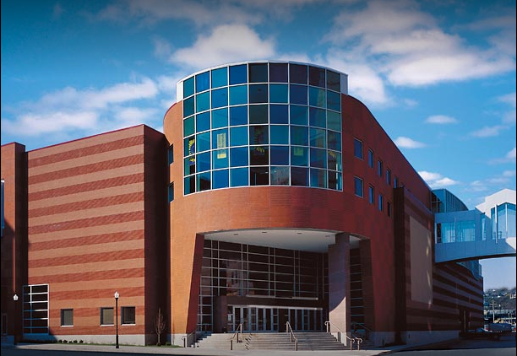
18th Annual
Lean Network Conference
Covington, Kentucky
Northern Kentucky Convention Center
10 W Rivercenter Blvd Covington, KY 41011
Ph: (859) 261-1500
Tuesday, May 12, 2020 - Full Day
Presentations, Workshops, Exhibitors & Evening Reception
Wednesday, May13, 2020 - Full Day
Presentations , Workshops , and Exhibitors

Slide 11


Slide 12
HNA What is New?
Upcoming Events
HOST
2020 Meeting Schedule
Topics for Discussion
Infectious Disease
Weather Policy
Copyright Information
2020 Wage and Benefit Survey
Supplier Stability Update

Slide 13
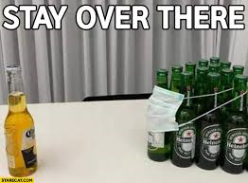
Coronavirus Update

Slide 14
COPYRIGHT PROTECTION REMINDER
Please remember that our Honda forms, documents, training material, etc. have copyrights attached to them. These include our 5P forms and documents, FMEA materials, Achieve Forum books, and etc.. Please take the time to ensure that you go over with your associates that these ARE NOT to be publically posted or photocopied. If you currently have Honda forms posted, please confirm that these are only on "locked down"/internal company sites that have associate-only access. If you need assistance in providing a secure place for associates to access needed documents, such as the 5P form, please let us know.

Slide 15
Questions?

Slide 16
Honda North America HR&E
SARG Mtg. Agenda
February 6, 2020
American Honda
101 Stanfield Road, Troy, OH
AGENDA
8:00 – 8:30 Registration & Lite Breakfast
8:30-9:30 Welcome and Introductions – HNA Top Exec. Updates - Patrick Easton, HNA
9:30-10:30 HR Interest Presentation – Anne Marie Singleton, McGohan Brabender 10:30-10:40 Break
10:40-11:40 Best Practice Presentation – “Using PDCA for Onboarding/Training Success” – Karolyn Hofacker, GTI
11:40 – 12:00 Lunch
12:00-1:00 Training Workshop – “Millennials & Generation Z: Reducing Attrition and Unlocking your Company’s Productivity” – Aurora Training Advantage
1:00-2:00 HMA Plant Tour
2:00-2:30 Supplier Stability Program/SARG Updates/Open Discussion
– Tim Hites & Julie Feltovich, HAM; Patrick Easton, HNA
2:30 Adjournment

Slide 17
February 2020 SARG
Thank You
2019 Honda Odyssey

Slide 18

Honda North America HR&E
SARG Mtg. Agenda
January 16, 2020
AIDT
46480 US-78
Lincoln, AL 35096
UPDATE
AGENDA
8:00 – 8:30 Registration & Lite Breakfast
9:00-9:15 Welcome, Introductions – Patrick Easton, HNA
9:15-10:00 Labor Update/Changes You Must Know/Open Discussion – Burr Forman
10:00 Head to Honda Manufacturing Alabama (directly across the street)
10:15-11:45 HMA Plant Tour
11:45 Head to AIDT (directly across the street)
11:45 – 12:30 Lunch
12:30-1:30 Top 10 Retirement Plan Internal Control Pitfalls and How to Avoid Them – Angela Coker, RSM
1:30 – 1:45 Break
1:45-2:30 SARG Updates/Open Discussion – Patrick Easton, HNA
2:30 Adjournment

Slide 19
Honda (Template)
Labor Campaign Response Team
June 2019
President
Company Attorney
HNA
Labor Steering Committee
Campaign Leader
HR
Manager
External
Communicator
Internal
Communicator
EPG / Division
Managers
Role & Responsibilities
President
To represent the company’s philosophy, history, positive attributes, team commitment, etc.
Stay removed from day to day communications and/or tactical activity
Company Attorney
To represent the company’s legal perspective, develop campaign strategy, file appropriate legal documents, avoid ULP’s, NLRB communications, internal “Do’s and Don’t” training, etc.
HNA Labor Steering Committee
Provide strategic HR, legal, communication and labor guidance, coordination and hands on support to NA Honda companies and related supplier companies to minimize labor risks and potential organizing efforts
HR Manager
Maintain all HR policies / practices, support all company campaign initiatives, provide input and direction, remain available to associates as they approach to talk and ask questions, etc.
EPG & All Others
Communicate a positive company message, understand facts about unionization (union dues, union constitutions, union history, etc.). Remain appraised of union campaign “Do’s and Don’ts”, listen to associates if they approach you with questions and/or concerns, maintain quality, delivery, safety, policy and other standard practices, etc.
Campaign Leader
One person to coordinate strategic and tactical planning and assure all company activity is going in same direction. Manages schedules, documentation, tracking, etc.
External Communicator
To represent the company to local media, businesses, public offices, elected officials, local industry, etc.
Someone the external contacts can relate to and maintains credibility (preferably already has relationships established)
Internal Communicator
To represent the company to associates and handles day to day communication. Is “face” of company during campaign
Someone the associates can relate to and maintains credibility (preferably already has relationships established)

