Slide 1
Session 1 - Part 1
1

Slide 2

Training Awareness for Production Floor Trainers & Supervisors
1

Slide 3
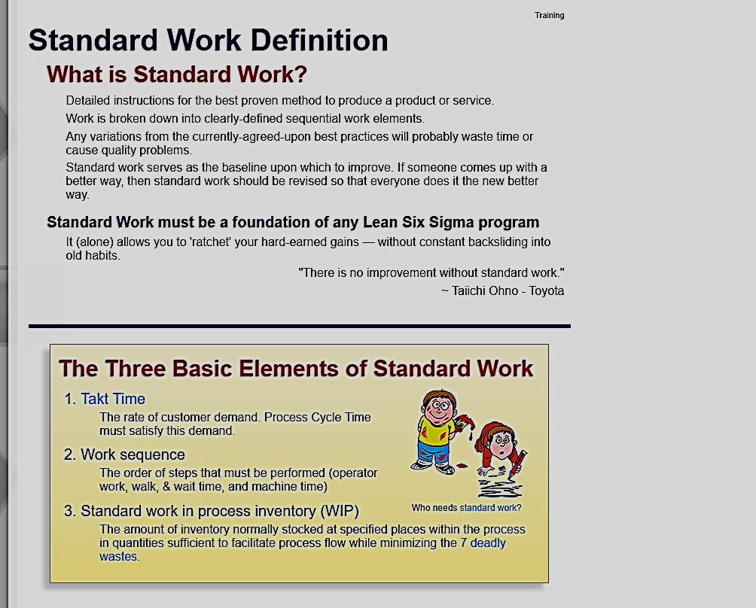
2
Notes:
Standard work should always be maintained. Without the base foundation of standardized work, there is no place from which to start for improvement.
Standard work focuses on the Associate, not the equipment or materials.
By standardizing and stabilizing work, safety, quality and cost is improved by removing the human variation from the process.
In other words, we are all going to do the same thing. We remove the – lets call it the Frank Sinatra syndrome: “I did it my why” by standardizing, we remove this part of the human element.

Slide 4
Standard work should always be maintained. Without the base foundation of standardized work, there is no place from which to start for improvement.
3

Slide 5
General Expectations
The Operation Standards must always be used.
When a Trainer/Supervisor is training, Standard work instruction is the first thing the Trainee should see.
The training process must always be followed .
Training paperwork, red training badges and the show and do method are part of that process. Any Trainer/Supervisor engaged in training must follow this method.
A Trainer should have only 3 trainings / containments.
Training is to be limited to a maximum of three Trainees per Trainer. It is very important that you allow enough time training in order to support each trainee. Keep in mind, depending on the difficulty of the process and the competence of the Trainee the amount of time needed will vary. Each Trainee will have a different level or style of learning, this can usually be determined within the first few minutes the Trainer spends with them. If they have a dazed or confused look this is a good indicator that the Trainer will need to spend a little more time with the Trainee.
4

Slide 6
Trainer Duties
Set an example: Learn the processes in your section.
(This is part of the Trainer Initiative and the training/sign off should be handled like any other Associate.)
Engage the Trainees in the training process.
Follow the Training Process as it is laid out. Including the process for sign off and containment.
5

Slide 7
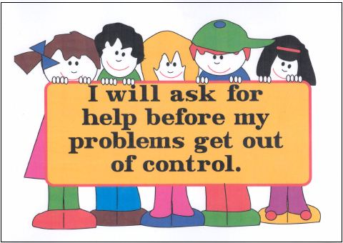
Trainers & Floor Supervisors can sometimes become overwhelmed. We all need to remember to be supportive of one another and ask for help when we feel in over our heads. Don’t let pride be your downfall ask for help.
6

Slide 8

Questions?

Slide 9
Session 1 - Part 2
1

Slide 10
Everyday Training Tools
Op Standards
It is mandatory (for everyone, including Supervisors) to always use the work instructions to ensure quality and repeatability.
Check, Work, Verify (CWV)
This is one of our standard operating procedures. This method is used for every part, every day, and in all departments.
Check – check the part before doing your work.
Work – perform your task.
Verify – verify the work you have completed before passing to the next position.
Touch Count
Another of the standard operating procedures: Verify all components (including IPL/ Part ID labels, they are components) with hands and eyes.
2

Slide 11
Everyday Training Tools
Calm Focused Approach
Don’t seem frazzled, rushed or unsure. This makes the Trainee feel the same way. Take the calm approach with the Operator and they will be calm. Focus on the Trainee and training. Being distracted creates a poor training/teaching environment.
Positive Intent Feedback
Focus on the positive aspects of the Operators work. Correct any errors immediately (by showing them the correct way) in a calm “let me show/help you” fashion.
Training Containment
This tool helps to provide positive intent feedback. It is a tool used to correct any training issues. When defects are found in training containment, the Operator can be made aware immediately and the correction can be made then and there. It is easier to correct mistakes at the beginning. If we wait, bad habits become ingrained and are harder to correct.
3

Slide 12
Everyday Training Tools
Training 5 Part Rule
The 5-part rule for training: When an Operator is in training, and the Trainer (or Shadow Buddy) observes the Operator is behind 5 parts or more, the process is slowed or stopped until the Operator can get caught up. If needed, help them to get caught up in a calm manner. Remember, the Trainee will not be at cycle time for the first few days. Do not panic them or make them rush through the process.
Objective of Training
Let the Operator know the objective of the training. For example: “I’m going to show you how to attach the seal to the part without stretching the seal.” Stated objective – learning to attach the seal to the part without stretching the seal.
Expectation of Training
Let the Operator know you don’t expect them to be perfect. Your expectation of their training is for them to learn to build a quality part in a safe timely manner. Speed will come with repetition. Build the part the same way, every part, every time, every day.
4

Slide 13
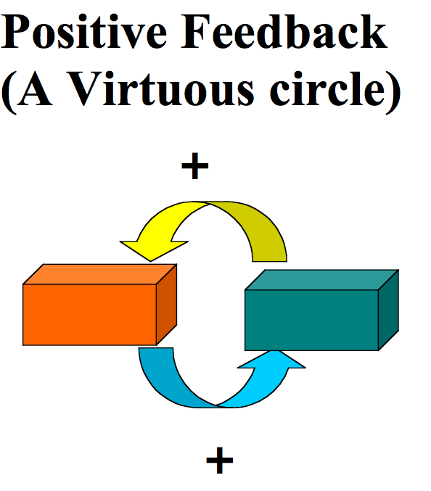
5

Slide 14
Positive Words, Powerful Results
Communicate positive feelings.
Provide valuable information.
Point out the good.
Tell the truth.
Offer to help.
Give approval.
Show courtesy and respect.
Apologize and be forgiving.
Share good news and a positive outlook.
Be inspiring.
Give a compliment .
6

Slide 15
Trainer Basics
Keep yourself clean. (This includes brushing teeth and washing hands. Smokers need to be very aware of this. People find the smoker smell very offensive.)
Keep your uniform clean and tidy. (Your laundry can hold offensive odors as well.)
Don’t wear strong scent. (Not only can it damage parts, some people are allergic.)
Respect personal space. (Training is up close and personal; however some people are uncomfortable when you invade their personal space too far. Have manners. Don’t over crowd. Also, if you sneeze, cough etc., cover your mouth. It is only polite.)
Gum chewing. (Don’t pop, crack, snap or smack your gum while training. Not only is it annoying, but it is distracting during the training process.)
7
Notes:
Let's talk a bit about reality.
No one likes bring up certain subjects, but we need to have a basic understanding.
(Read and discuss the slide)

Slide 16

Questions?
(Remember: Questions are the keys to knowledge and understanding)

