Slide 1
Microsoft Teams
Instructions for Phones/Tablets with app

Slide 2
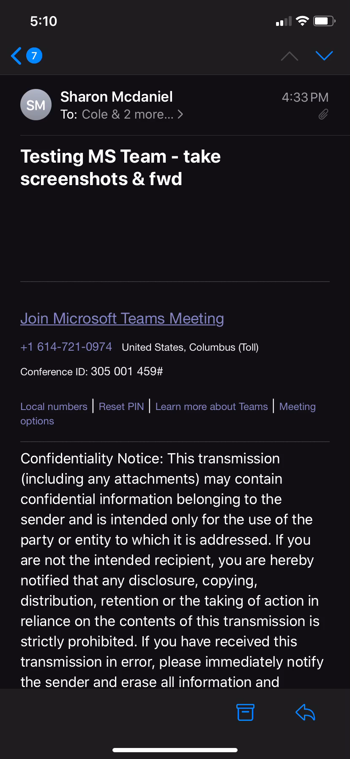
Instructions for Phones/Tablets with app
Video instruction (length: 18 seconds)
  Click on picture
  Hit play

Slide 3
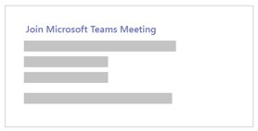


Instructions for Phones/Tablets with app
Step 1 – Open email invitation; click on Join Microsoft Teams Meeting
Step 2 – Choose Join as a guest
Step 3 – a) Enter Full Name
        b) Turn off video
        c) Turn off Audio (Mic)
        d) Select Join Now
Step 4 – Wait in the lobby until you receive access

