Slide 1
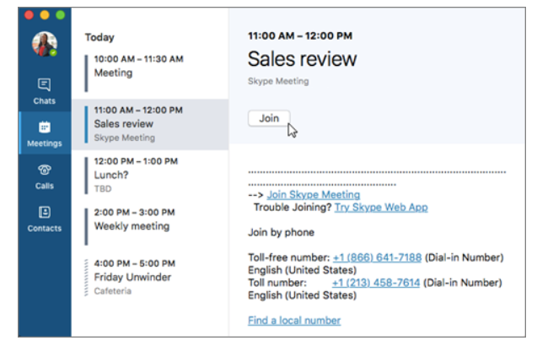
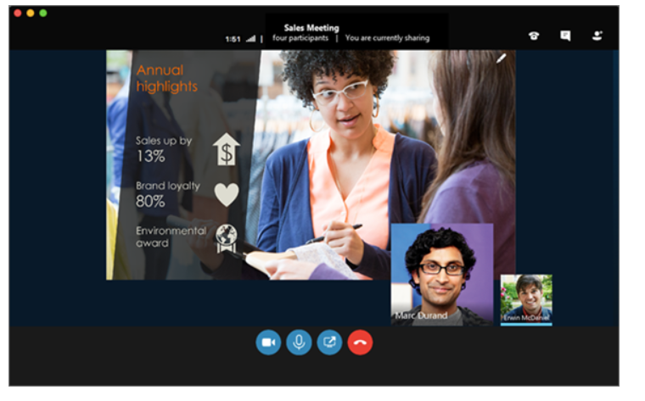
Skype for Business for MAC
Join with Skype for Business on Mac
In the Skype for Business on Mac main window, find and double-click the meeting you want to attend, or click the Join button.
Welcome to the meeting

Slide 2
IM – Instant Messaging
To send an IM to meeting participants, click the button.

Slide 3
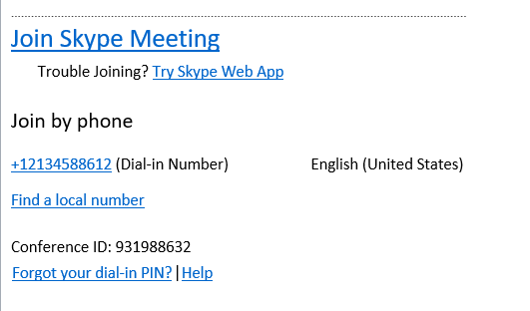
Steps for Skype Dialing-In Audio
USE IF COMPUTER AUDIO IS NOT AVAILABLE
To call into the meeting from your phone, call the dial-in number and enter the Participant code when prompted.
Dial-In Number: The Skype dial-in number is based on your location base (it is not an 800 number). If you are away on business and need to join a Skype meeting, you have the option of finding a local number for your area by clicking the 'Find a local number' selection in the Skype meeting details.
2. At the specified time, dial your audio conference telephone number.
3. When prompted, enter your conference ID (10 digit number)
followed by #.
Sample Dial-in Number
Sample Conference ID

