Slide 1
Join a Skype for Business meeting Video
CLICK HERE

Slide 2
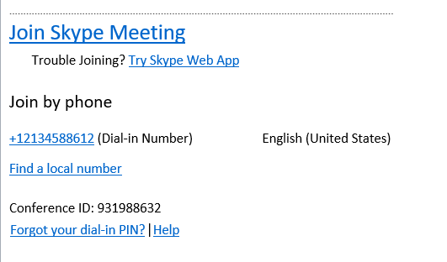
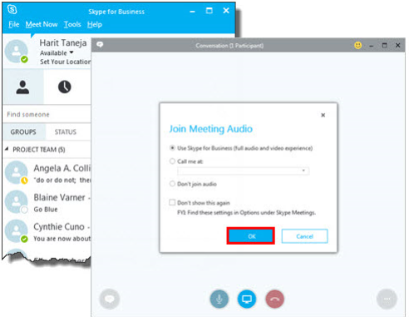
STEP 1a & 1b:
Skype for Business lets you quickly connect with others across
your company and around the world.
Open the Outlook meeting invitation in your email or calendar and click the Join Skype Meeting link.
The Skype for Business main window will appear briefly as Skype for Business opens.
The Join Meeting Audio screen will appear. Choose the most appropriate audio option:
Once an audio option is selected, click OK to join your meeting via web and audio.
1a. Click on
“Join Skype Meeting”
1b. Select the
Audio option
best for you

Slide 3
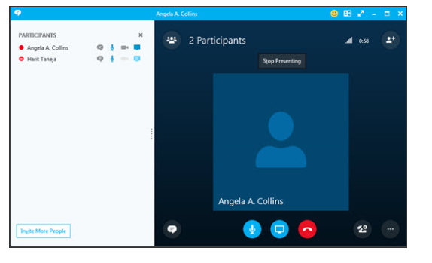
STEP 2:
The Skype for Business meeting window will appear. You have now joined your scheduled meeting.
Click icon for “Instant Message” to ask questions

Slide 4
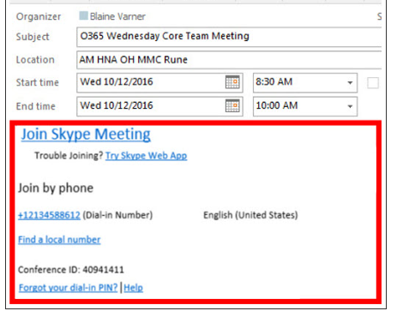
Audio: Dial-In if Computer audio is not Working
To call into the meeting from your phone, call the dial-in number and enter the Participant code when prompted.
Dial-In Number: The Skype dial-in number is based on your location base (it is not an 800 number). If you are away on business and need to join a Skype meeting, you have the option of finding a local number for your area by clicking the 'Find a local number' selection in the Skype meeting details.
2. At the specified time, dial your audio conference telephone number.
3. When prompted, enter your conference ID (10 digit number)
followed by #.
Sample Dial-in Number
Sample Conference ID

Slide 5
Set Video Device options in Skype for Business video
CLICK HERE

