Slide 1
Skype for Business (desktop)
Join the meeting
To join the meeting, do the following:
At meeting time, open your Skype for Business email invitation, and then click Join online meeting in the email message.
If this is the first time you are joining a meeting, your browser might ask you to download Skype Meetings App. Click Join with Skype for Business (desktop)
In the Skype for Business (desktop) a Welcome screen that opens, type your name in the Enter your name text box, and then click Join.
More in-depth steps in next slides….

Slide 2
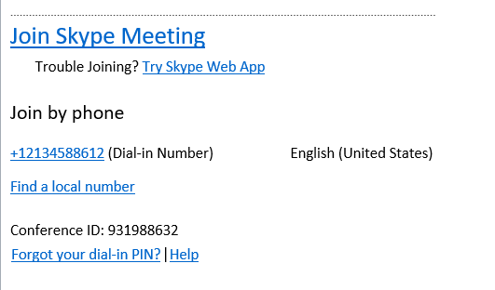
STEP 1:
Open the Outlook meeting invitation in your email or calendar and click the Join Skype Meeting link.
If this is your first time using the Skype for Business Web App, follow your browser's instructions for installing the Skype for Business Web App Plug-in, which is required for audio and screen sharing.
Check the Always allow the plug-in for this domain box.
Click Allow.
Click on “Join Skype Meeting”

Slide 3
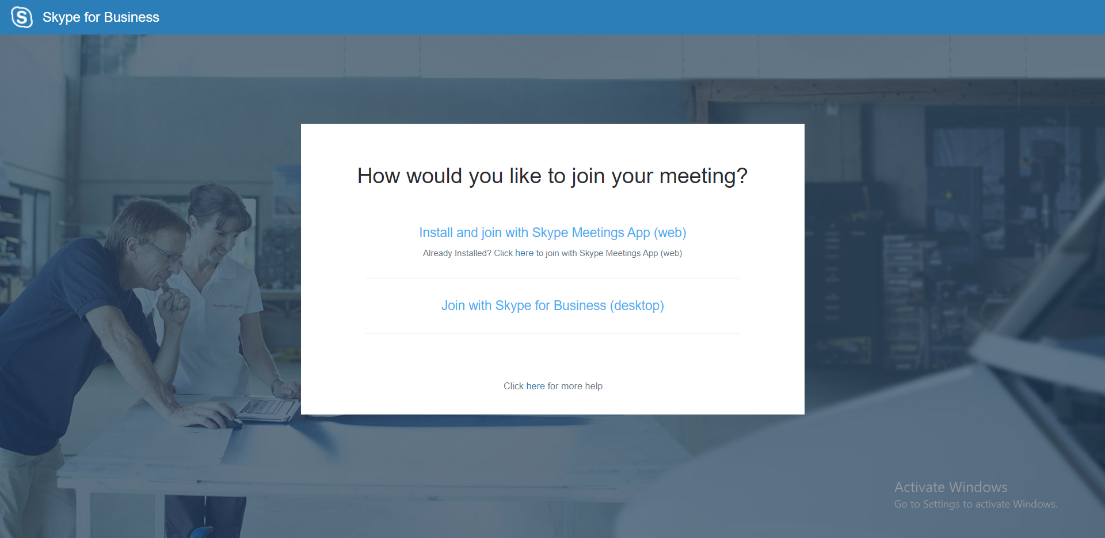
STEP 2:
After clicking Join Skype Meeting link. The image below should pop up…
Join with Skype for Business
(desktop)
Now click on “Join with Skype for Business (desktop)”

Slide 4
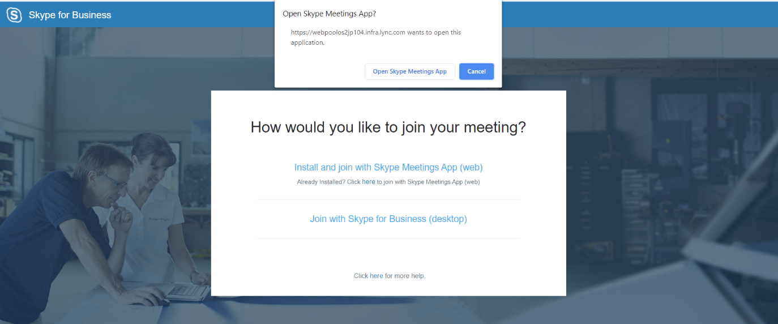
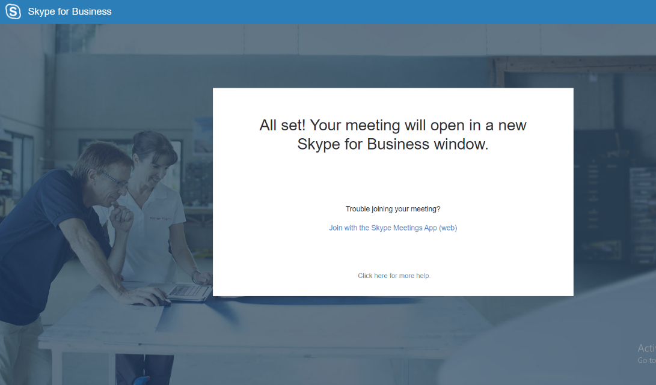
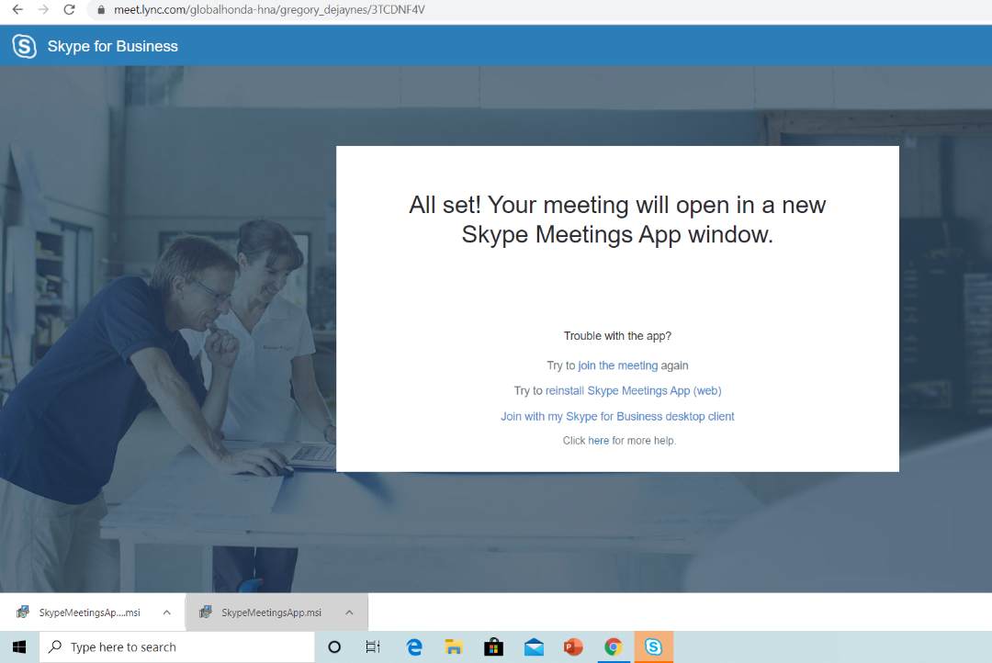
STEP 3:
Here is what will be seen when installing Join with Skype for Business (desktop)
Click the “Open Skype Meetings App” if it does not download automatically
Click the Skype Icon in your task bar if the App window did not pop up.

Slide 5
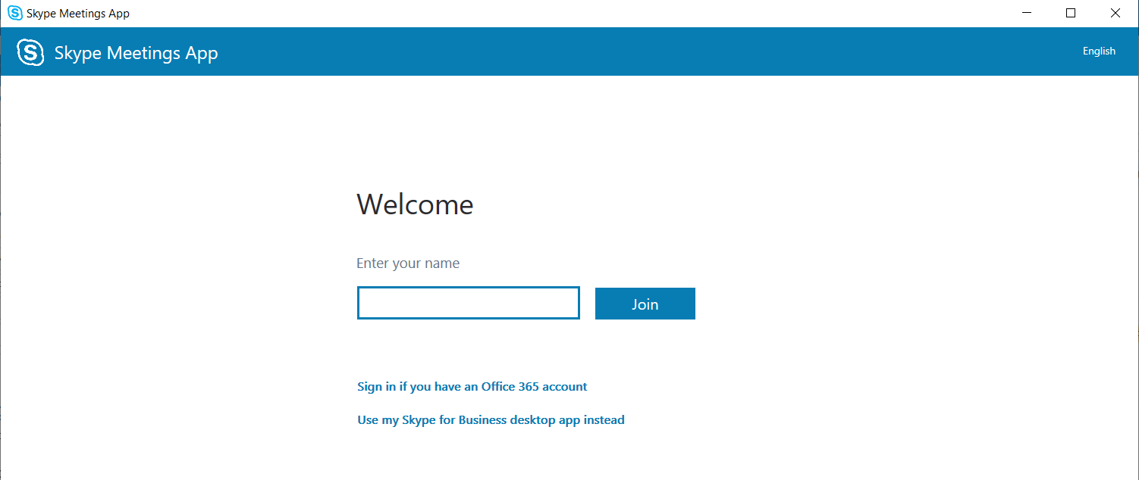
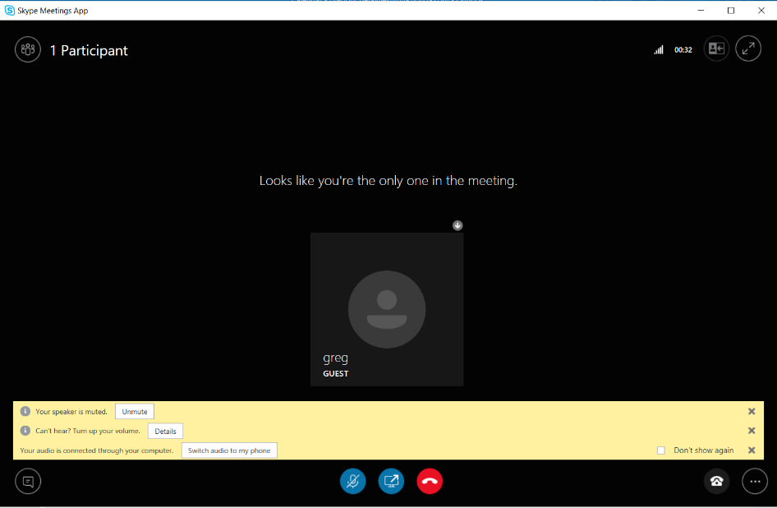
STEP 4:
Type in your name and click “Join”.
The first time you join a Skype Meeting from the Skype for Business (desktop), you're connected to the meeting audio by using a Skype Call through your device's headset or mic and speakers.
Click icon for “Instant Message” to ask questions

Slide 6
Steps for Skype Dialing-In Audio
USE IF COMPUTER AUDIO IS NOT AVAILABLE
To call into the meeting from your phone, call the dial-in number and enter the Participant code when prompted.
Dial-In Number: The Skype dial-in number is based on your location base (it is not an 800 number). If you are away on business and need to join a Skype meeting, you have the option of finding a local number for your area by clicking the 'Find a local number' selection in the Skype meeting details.
2. At the specified time, dial your audio conference telephone number.
3. When prompted, enter your conference ID (10 digit number)
followed by #.
Sample Dial-in Number
Sample Conference ID

